Slide 1
Constructors
Prepared By: Dimple Bohra

Slide 2
What is Constructor
A constructor is a special method that is used to initialize a newly created object.
It is called when an instance of the class is created.
It can be used to initialize the objects to desired values or default values at the time of object creation.
It is not mandatory for the coder to write a constructor for a class

Slide 3
class MyClass
{
int x = 5,y=10;
public static void main(String[] args)
{
MyClass myObj1 = new MyClass(); // Object 1
MyClass myObj2 = new MyClass(); // Object 2
System.out.println(myObj1.x);
System.out.println(myObj2.y);
}
}
x
myObj1
y
x
myObj2
y

Slide 4
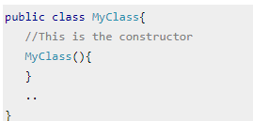
Rules for creating Constructor
Constructor name must be the same as its class name
A Constructor must have no explicit return type (not even void)

Slide 5
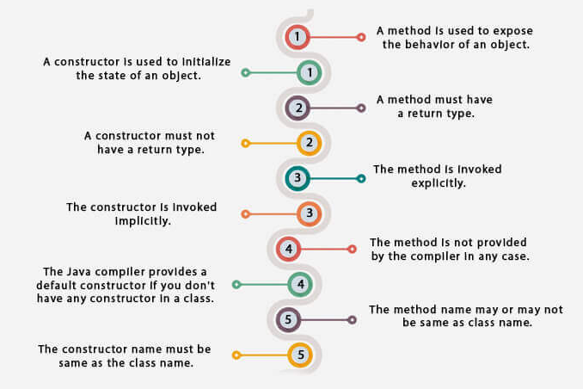
Difference between constructor and method

Slide 6
Types of Constructor
Default constructor (no-arguments constructor)
Parameterized constructor

Slide 7
Purpose of default constructor
The default constructor is used to provide the default values to the object like 0, null, etc., depending on the type
E.g.
numeric data types are set to 0
char data types are set to null character(‘\0’)
reference variables are set to null

Slide 8
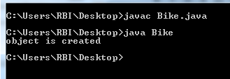
Program on default constructor
class Bike
{
Bike()
{
System.out.println("object is created");
}
public static void main(String args[])
{
Bike b1=new Bike();
}
}

Slide 9
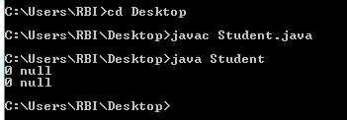
Program on default constructor
class Student
{
int id;
String name;
void display()
{ System.out.println(id+" "+name);
}
public static void main(String args[])
{
Student s1=new Student();
Student s2=new Student();
s1.display();
s2.display();
}
}

Slide 10
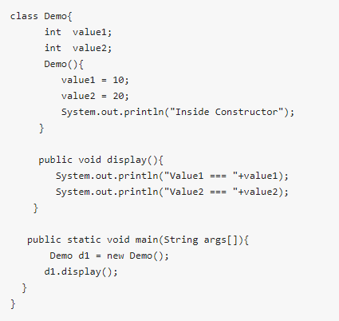

Slide 11
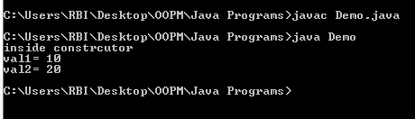
class Demo{
int val1,val2;
Demo()
{
val1=10;
val2=20;
System.out.println("inside constrcutor");
}
public void display()
{
System.out.println("val1="+" "+val1);
System.out.println("val2="+" "+val2);
}
public static void main(String args[])
{
Demo d1=new Demo();
d1.display();
}
}

Slide 12

Example of parameterized constructor
public class Construct
{
String studentName;
int studentAge;
Construct(String name, int age)
{
studentName = name;
studentAge = age;
}
void display()
{
System.out.println(studentName+ " "+studentAge);
}
public static void main(String args[])
{
Construct myObj = new Construct("Amar" , 19);
myObj.display();
}
}

Slide 13

Constructor Overloading
Constructor overloading is a technique in Java in which a class can have any number of constructors that differ in parameter list.
The compiler differentiates these constructors by taking into account the number of parameters in the list and their type.

Slide 14

Example of constructor overloading
public class Rectangle{
int length;
int breadth;
String color;
Rectangle( int l , int b){
length = l;
breadth = b;
color = "Blue";
}
Rectangle(int l, int b, String c){
length = l;
breadth = b;
color = c;
}
void display(){
System.out.println("Length-" + length +" "+ "Breadth-" + breadth+ " "+"Color-" + color);
}
public static void main(String args[]){
Rectangle obj1 = new Rectangle(2,4);
Rectangle obj2 = new Rectangle(2,4,"Green");
obj1.display();
obj2.display();
}
}

Slide 15
Constructor Chaining
Constructor chaining is the process of calling one constructor from another constructor with respect to current object.
Constructor chaining can be done in two ways:
Within same class: It can be done using this() keyword for constructors in same class
From base class: by using super() keyword to call constructor from the base class.

Slide 16
Constructor Chaining
The real purpose of Constructor Chaining is that you can pass parameters through a bunch of different constructors, but only have the initialization done in a single place.
This allows you to maintain your initializations from a single location, while providing multiple constructors to the user.
If we don’t chain, and two different constructors require a specific parameter, you will have to initialize that parameter twice, and when the initialization changes, you’ll have to change it in every constructor, instead of just the one.

Slide 17
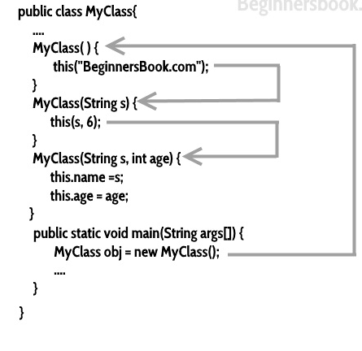
Constructor Chaining
As a rule, constructors with fewer arguments should call those with more

Slide 18
super and this keywords in Java
super keyword is used to access methods of the parent class while this is used to access methods of the current class.
This and super are reserved keywords in java i.e, we can’t use them as an identifier.
‘this’ is a reference variable that refers to the current object and can be used in various ways:
Using this() to invoke current class constructor
Using ‘this’ keyword to return the current class instance
Using ‘this’ keyword as method parameter
Using ‘this’ keyword to invoke current class method

Slide 19

class Test
{
int a;
int b;
// Parameterized constructor
Test(int a, int b)
{
this.a = a;
this.b = b;
}
void display()
{
System.out.println("a = " + a + "b = "+ b);
}
public static void main(String[] args)
{
Test object = new Test(10, 20);
object.display();
}
}
‘this’ used as reference variable

Slide 20
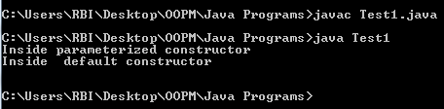
class Test1
{
int a;
int b;
Test1()
{
this(10, 20);
System.out.println("Inside default constructor \n");
}
Test1(int a, int b)
{
this.a = a;
this.b = b;
System.out.println("Inside parameterized constructor");
}
public static void main(String[] args)
{
Test1 object = new Test1();
}
}
‘this()’ to invoke current class constructor

Slide 21

class Test2
{
int a;
int b;
Test2()
{
a = 10;
b = 20;
}
Test2 get()
{
return this;
}
void display()
{
System.out.println("a = " + a + " b = " + b);
}
public static void main(String[] args)
{
Test2 object = new Test2();
object.get().display();
}
}
Using ‘this’ keyword to return the current class instance

Slide 22

Using ‘this’ keyword as method parameter
class Test3
{
int a;
int b;
Test3()
{
a = 10;
b = 20;
}
void display(Test3 obj)
{
System.out.println("a = " + a + " b = " + b);
}
void get()
{
display(this);
}
public static void main(String[] args)
{
Test3 object = new Test3();
object.get();
} }

Slide 23
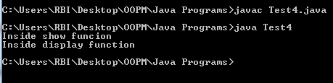
Using ‘this’ keyword to invoke current class method
class Test4 {
void display()
{
this.show();
System.out.println("Inside display function");
}
void show()
{
System.out.println("Inside show funcion");
}
public static void main(String args[])
{
Test4 t1 = new Test4();
t1.display();
}
}

Slide 24
super keyword
The super keyword in java is a reference variable that is used to refer parent class objects. The keyword “super” came into the picture with the concept of Inheritance. It is majorly used in the following contexts:
Use of super with variables
Use of super with methods
Use of super with constructors

Slide 25
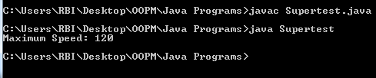
Use of super with variables
class Vehicle
{
int maxSpeed = 120;
}
class Car extends Vehicle
{
int maxSpeed = 180;
void display()
{
System.out.println("Maximum Speed: " + super.maxSpeed);
}
}
class Supertest
{
public static void main(String[] args)
{
Car small = new Car();
small.display();
}
}
Notes:
Use of super with variables: This scenario occurs when a derived class and base class has same data members. In that case there is a possibility of ambiguity for the JVM.

Slide 26
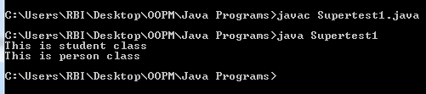
Use of super with method
class Person
{
void message()
{
System.out.println("This is person class");
}
}
class Student extends Person
{
void message()
{
System.out.println("This is student class");
}
void display()
{
message();
super.message();
}
}
class Supertest1
{
public static void main(String args[])
{
Student s = new Student();
s.display();
}
}
Notes:
This is used when we want to call parent class method. So whenever a parent and child class have same named methods then to resolve ambiguity we use super keyword.

Slide 27
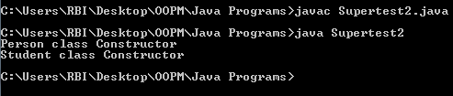
Use of super with constructor
class Person
{
Person()
{
System.out.println("Person class Constructor");
}
}
class Student extends Person
{
Student()
{
super();
System.out.println("Student class Constructor");
}
}
class Supertest2
{
public static void main(String[] args)
{
Student s = new Student();
}
}
Notes:
super keyword can also be used to access the parent class constructor. One more important thing is that, ‘’super’ can call both parametric as well as nonparametric constructors depending upon the situation.

Slide 28
Points to remember
You should call super() and this() calling statements inside the constructors only and they must be first statement in the constructors.
You can’t use super and this keywords in a static method and in a static initialization block even though you are referring static members.

Slide 29
Destructor
It is a special method called when the object’s lifecycle is over, in order to free memory and deallocate resources.
Java does not have destructors rather it has Garbage Collector.
The garbage collector is a program that runs on the JVM and recovers memory by deleting objects that are not used anymore or are not accessible from the code (and are considered garbage, hence the name).
It runs automatically and periodically checks the references in contrast to the objects in the memory heap. If an unreferenced object is found, that means that there is no way to access it anymore and it is useless, so the garbage collector gets rid of it and frees the memory.
In C++, ~Test(){ }

Slide 30
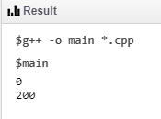
using namespace std;
class construct
{
public:
float area;
// Constructor with no parameters
construct()
{
area = 0;
}
// Constructor with two parameters
construct(int a, int b)
{
area = a * b;
}
void disp()
{
cout<< area<< endl;
}
};
Constructor overloading in C++
int main()
{
construct o;
construct o2( 10, 20);
o.disp();
o2.disp();
return 1;
}

Slide 31
Thank You

